Slide 1
Can We Predict the Outcome of a Boxing Match?

Slide 2
Industry Problem
There are many boxing enthusiasts who place bets on their predictions for the outcome of a fight. There is a significant amount of money made and lost in this industry. This has led to the pursuit of ways to objectively improve predictions, maximize betting success rates, and guarantee financial gain.

Slide 3
The Question:
Can the outcome of a fight be predicted using
Historical performance metrics
Biometric measurements
Win/loss records

Slide 4
Outline Of The Initial Plan To Solve The Problem
  Identify and isolate columns containing desired metrics that can be used to create the final prediction model
  Separate data into categories reflecting performance, biometrics, and win/loss records
  Calculate win percent and use visualizations and statistical exploration to identify metrics that demonstrate a strong correlation with win percent
  Using Statsmodels, formulate best fit statistical models that take a value or group of values, and predicts a fighter’s probability to win
  Create an algorithm that compares 2 fighters and predicts the outcome of a future fight using the model from step 4

Slide 5
The Initial Data:
Source: https://www.kaggle.com/rajeevw/ufcdata#data.csv
Records: Measurements taken from 5144 Fights between 1993 and 2019
Columns: 145
Noisy Data set with many missing values, incomplete records, redundancy

Slide 6
Data Cleaning and Restructuring
Dropped columns with information not necessary for development of the final algorithm
Restructured the data frame to achieve information for 1 fighter per row
Dropped null values
Dropped rows with extreme outlier values resulting from averages taken over less than 5 fights

Slide 7
Cleaned and Ready Data
Performance Metrics
Average Knock Downs Per Round
Average Head Strikes Per Round
Average Take Downs Per Round
Average Total Strikes Per Round
Average Significant Striker Per Round
Total Career Title Bouts
1993 Records, 18 Data columns
6 Performance Metrics
4 Biometric Measurements
8 Win/Loss History Metrics
Win/Loss History
Current Lose Streak
Current Win Streak
Total CareerLosses
Total Career Wins
Career Wins by Knockout
Career Total Fights
Longest Winning Streak
Win Percent
Biometric Measurements
Height
Weight
Reach
Age

Slide 8
Column Name | Description
Fighter | The full name of the fighter
current_lose_streak | The fighter’s current number of subsequent losses
current_win_streak | The fighter’s current number of subsequent wins
avg_head_landed | The fighter’s average number of landed strikes to the opponent’s head per round
avg_KD | The fighter’s average number of knockdowns per round
avg_sig_str_landed | The fighter’s average significant strikes landed on the opponent per round
avg_td_landed | The fighter’s average takedowns of the opponent per round
avg_total_str_landed | The fighter’s average total strikes landed per round
longest_winning_streak | The fighter’s longest career losing streak
losses | The fighter’s total career losses
total_title_bouts | The fighter’s total career title bouts
win_by_ko/tko | The fighter’s total career wins by knockout
wins | The fighter’s total career wins
height_cms | The fighter’s height in centimeters
reach_cms | The fighter’s reach in centimeters
weight_lbs | The fighter’s weight in lbs.
age | The fighter’s current age
total_fights | The fighters total career wins + losses
win_percent | The fighters total career wins divided by their total career fights

Slide 9
Cleaned and Ready Data
Column Name | Object Type
Fighter | 1993 non-null object
current_lose_streak | 1993 non-null int64
current_win_streak | 1993 non-null int64
avg_head_landed | 1993 non-null float64
avg_KD | 1993 non-null float64
avg_sig_str_landed | 1993 non-null float64
avg_td_landed | 1993 non-null float64
avg_total_str_landed | 1993 non-null float64
longest_winning_streak | 1993 non-null int64
losses | 1993 non-null int64
total_title_bouts | 1993 non-null int64
win_by_ko/tko | 1993 non-null int64
wins | 1993 non-null int64
stance | 1993 non-null object
height_cms | 1993 non-null float64
reach_cms | 1993 non-null float64
weight_lbs | 1993 non-null float64
age | 1993 non-null float64
total_fights | 1993 non-null int64
win_percent | 1993 non-null float64

Slide 10
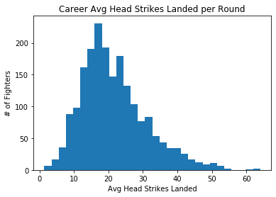
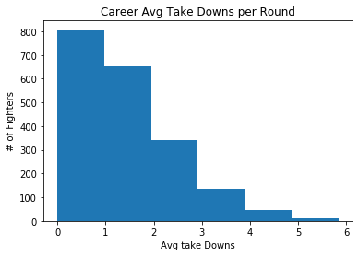
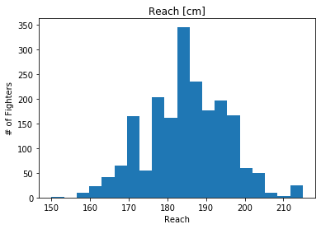
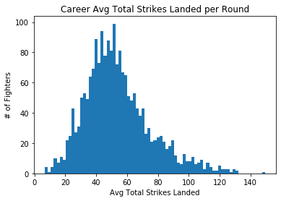
Visualization and Exploration
Visualization and Exploration
Initial Histograms:
Insights into midpoint and spread
Performance metrics demonstrated R tailed distribution
Biometric measurements demonstrated centered distributions with
Win/Loss records had weak central tendencies

Slide 11
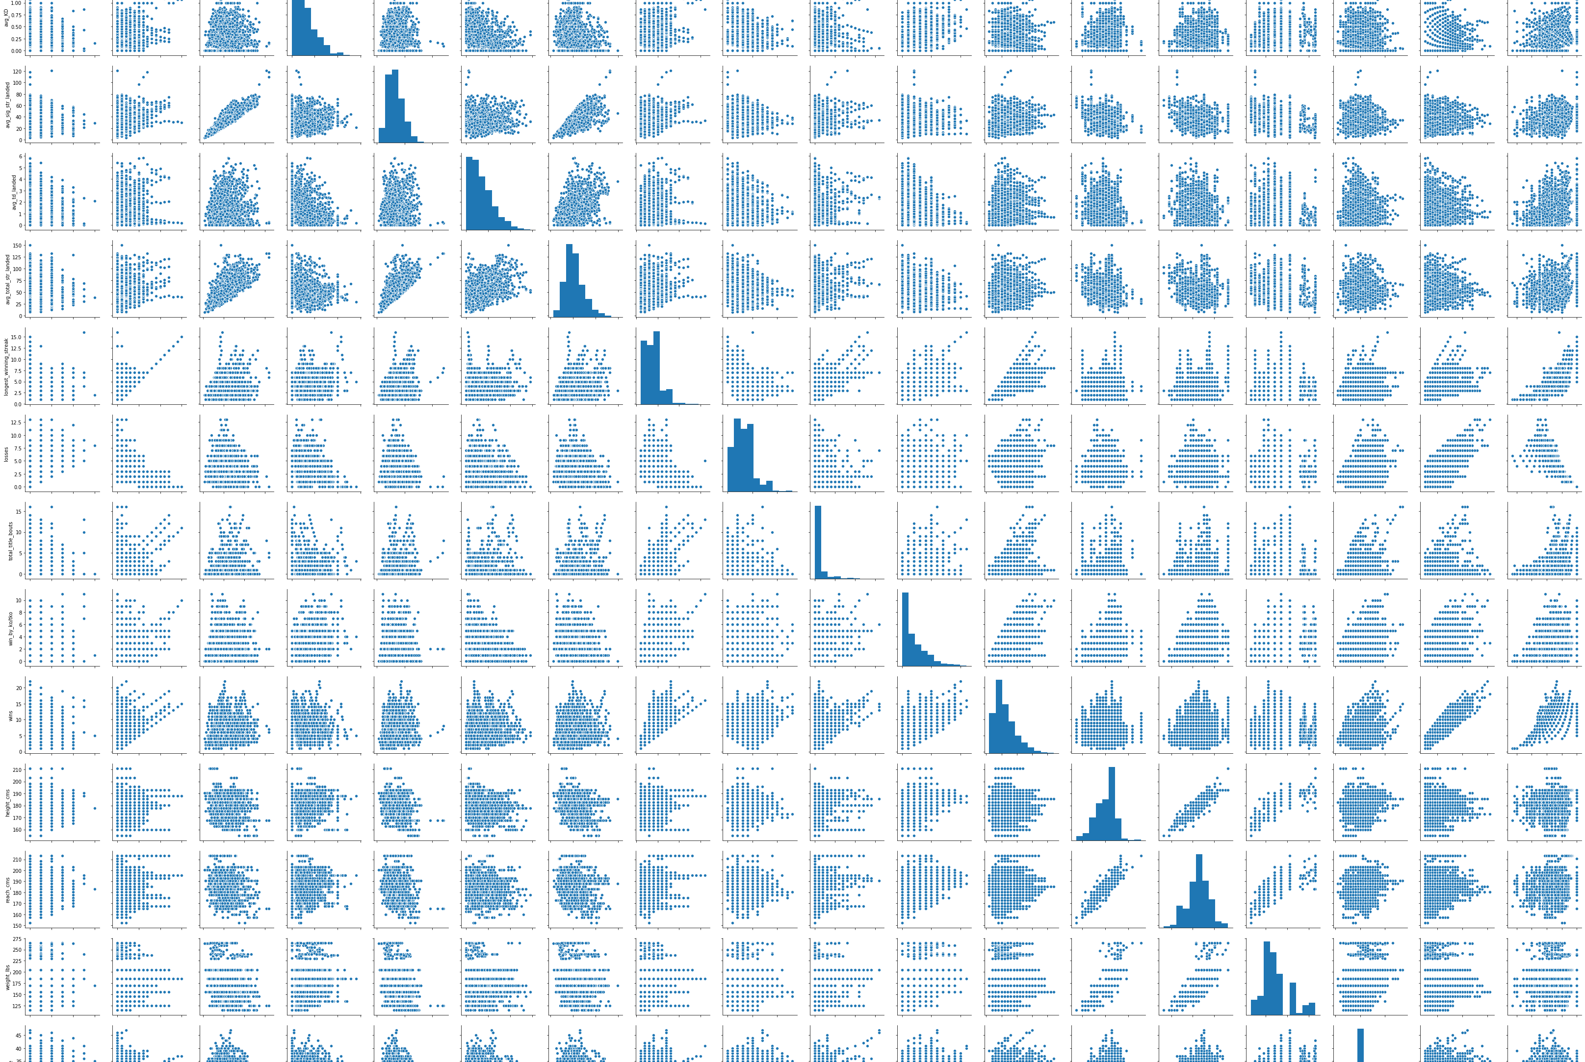
Pear Plot
Visualization and Exploration

Slide 12
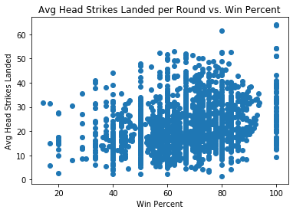
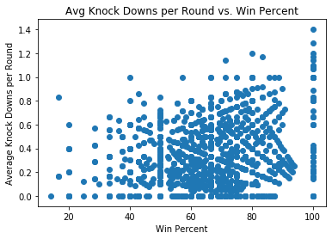
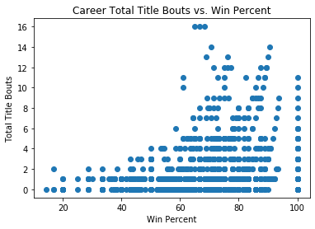
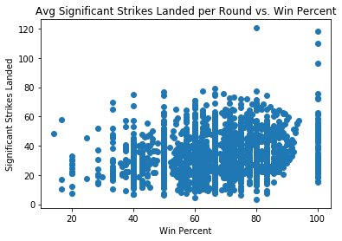
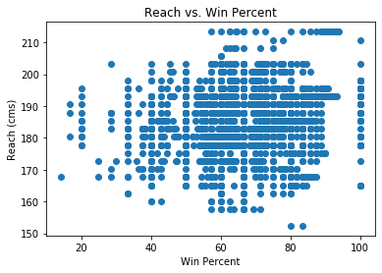
Scatter plots
Visualization and Exploration
Plotted each metric vs. win percent, findings were inconclusive

Slide 13
Statistical Investigation: Correlations
Metric | Correlation with Win Percent
Current Lose Streak Correlation with Win Percent | -0.45444229961822463
Current Win Streak Correlation with Win Percent | 0.5935028985617277
Head Strikes Landed correlation with Win Percent | 0.2259392985933221
Knockdowns correlation with Win Percent | 0.2127045354102693
Significant Strikes Landed Correlation with Win Percent | 0.20255800847914524
Average Take Downs Correlation with Win Percent | 0.23771622131399475
Average Total Strikes Landed Correlation with Win Percent | 0.17737205092568312
Longest Winning Streak Correlation with Win Percent | 0.6463959923883718
Total Tile Bouts Correlation with Win Percent | 0.2612907181416824
Total Wins By Knockout Correlation with Win Percent | 0.286489944539576
Height Correlation with Win Percent | 0.06059615713029151
Reach Correlation with Win Percent | 0.12333530695772818
Weight Correlation with Win Percent | 0.05641010603308878
Age Correlation with Win Percent | -0.0882501053360032
Total Fights Correlation with Win Percent | 0.0354733049856339

Slide 14
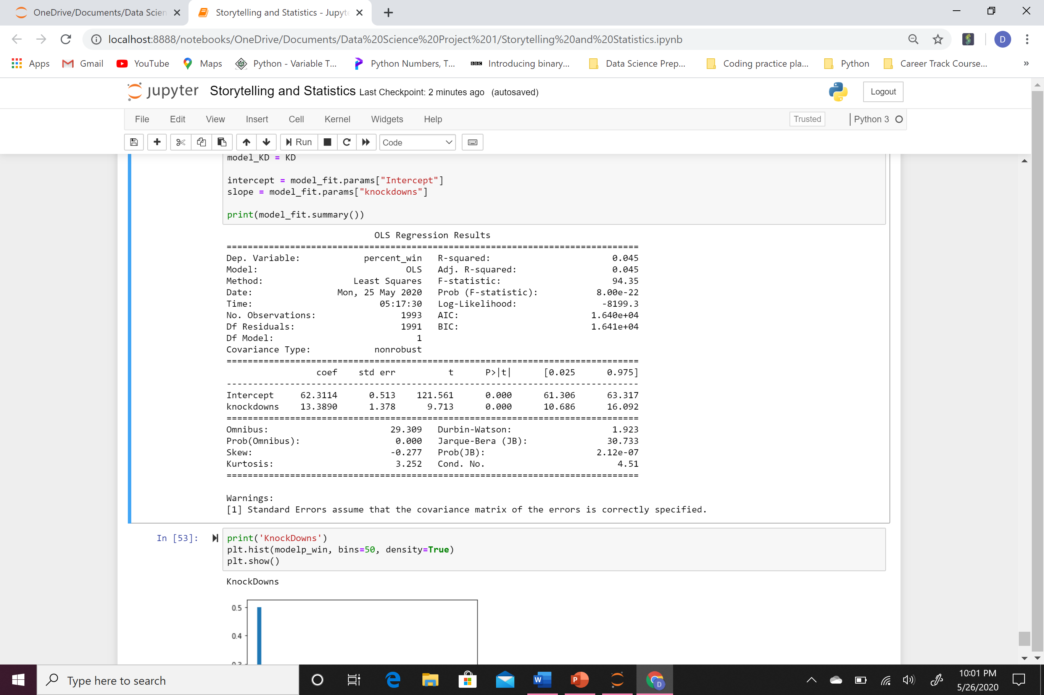
Outcomes of Ordinary Least Squares: Example Table
Statistical Modeling

Slide 15
Model Results
Used Python’s Statsmodels package to create a best fit liner model for each metric using the ordinary least squares method.
Unfortunately, the strongest models that could be created still resulted in large residual differences between the model predictions and the data, small R-squared values, and negative log-likelihoods
While the models predicted “conceivably realistic” win percentages, they did not closely reflect the actual data off which they were created.

Slide 16
Preliminary Conclusions
The correlations between the individual observed metrics and win percentages of the fighters were not strong
Consequently, confidence in the accuracy of the prediction models and usefulness of the data they produce is not strong
Next, I will take a deeper look using multivariant analysis, to build more accurate models

